Slide 1
Study Group: Simulation
OFFICIAL : SENSITIVE
GFSA Autumn Quarterly
Tom Perry, Dugald Hepburn & Caitlin Mitchell

Slide 2
Agenda
OFFICIAL : SENSITIVE
Simulation overview
What is a Simulation?
Why use Simulation?
How do we build a Simulation?
Key Simulation techniques
Monte Carlo simulation
System dynamics
Discrete event simulation
Agent-based modelling
3. Case Study: Crown Court Backlog
Why simulation?
Understanding the system
Which type of simulation?
Simulation design
Data collection
Analysis of outputs
Experimentation
Sensitivity analysis
4. Lessons learned

Slide 3
What is Simulation?
OFFICIAL : SENSITIVE
The representation of the system via objects and activities
“The process of mathematical modelling, performed on a computer, which is designed to predict the behaviour of, or the outcome of, a real-world or physical system”
Allows us to answer “what if” questions about the system under different scenarios
The underlying process which the modeller is looking to replicate

Slide 4
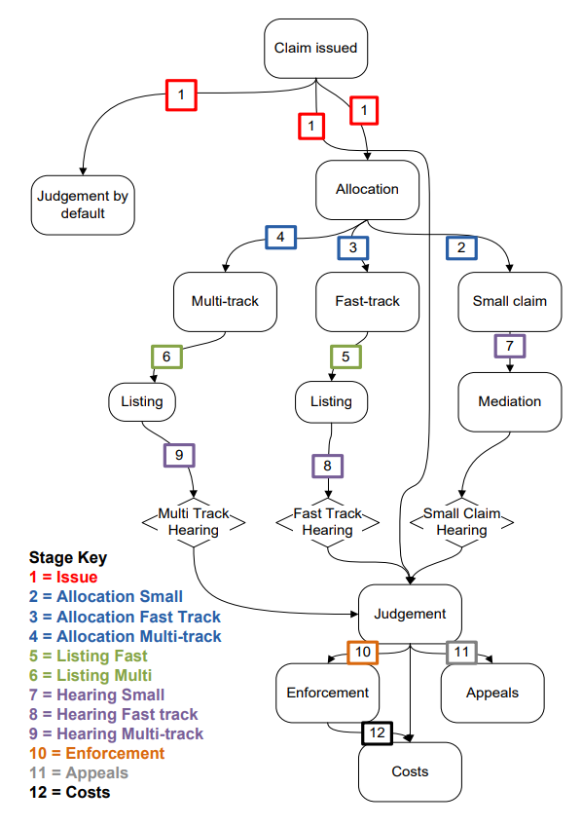
Examples of simulation in government
OFFICIAL : SENSITIVE
Many OR projects that look at large, complex systems can be modelled (with relative ease) by using simulation.
For example, these could be used in government for modelling:
Waiting lists (NHS waiting times, backlog in courts, asylum applications)
Processes (NHS treatment pathways, navigating the courts, applying for visas)
Costs
These can usually be displayed through flow charts, or at least visually!
The example on the right is taken from the GORS project catalogue on court case progression.
Notes:
Understanding customer pathways / processes
Backlogs / bottlenecks / improving flow through the system

Slide 5
How do we go about building a simulation?
OFFICIAL : SENSITIVE
1. Simulation Design
What type of simulation do we need for
our system?
2. Data Collection & Parametrization
Which parameters should our model have?
3. Output Analysis & Validation
Does the model accurately reflect the system?
4. Experimentation
How does the model perform under different scenarios?
5. Sensitivity Analysis
What effect does the changing of parameters
have on our outputs?

Slide 6
Why use Simulation?
OFFICIAL : SENSITIVE
Advantages
Simplicity of concept – analysis can be easily explained to stakeholders or customers
Useful for detecting bottlenecks and testing methods to increase system flow
Time horizon can be adapted with ease
Easy to produce confidence intervals
We can set and test arbitrary assumptions easily (“what if” questions)
We can use real-world observations to influence our models using different statistical distributions
To be aware of
Randomness involved means that sophisticated output analysis is required to draw meaningful conclusions
A mathematically optimal solution is never found
Quality of the simulation dictated by quality of the input data – can be hard to source!

Slide 7
Which type of Simulation do I need?
OFFICIAL : SENSITIVE
System model
Parameters known or variable?
Deterministic
Probabilistic
Time frame?
Static
Dynamic
Static
(Monte Carlo)
Dynamic
When can the state of the system change?
Discrete
Continuous
Discrete
(Discrete event)
Stochastic

Slide 8
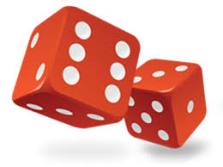



What are key Simulation techniques?
OFFICIAL : SENSITIVE
Monte Carlo simulation
System dynamics
Discrete event simulation
Agent-based modelling

Slide 9

Monte Carlo: multiple probability simulation
OFFICIAL : SENSITIVE
Uses repeated random sampling to obtain the likelihood of a range of results occurring.
Invented during World War II to improve decision making under uncertain conditions
Builds a model of possible results by leveraging a probability distribution for any variable which has inherent uncertainty. Recalculating the results over and over – often thousands of times – yields the probability of each result occurring.
Simple application: Rolling two dice and predicting the sum – 36 different combinations – can manually calculate the probability of each. Simulating rolling the dice 10,000 times, using Monte Carlo, will yield a probability distribution for each sum.
https://www.ibm.com/topics/monte-carlo-simulation
Notes:
A type of computational algorithm which uses repeated random sampling to obtain the likelihood of a range of results occurring.
One simple example of a Monte Carlo Simulation is to consider calculating the probability of rolling two standard dice. There are 36 combinations of dice rolls. Based on this, you can manually compute the probability of a particular outcome. Using a Monte Carlo Simulation, you can simulate rolling the dice 10,000 times (or more) to achieve more accurate predictions.

Slide 10
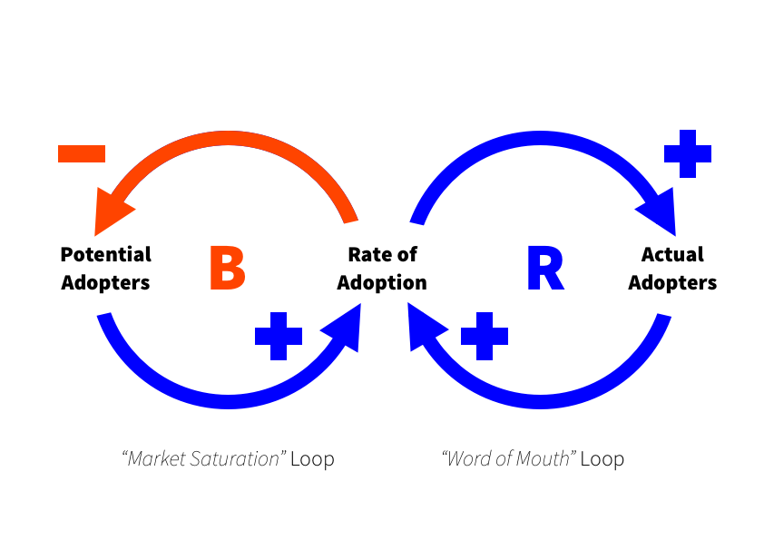
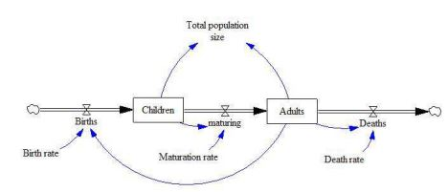

System Dynamics: stocks and flows
OFFICIAL : SENSITIVE
Approach to understanding the nonlinear behaviour of complex systems over time using stocks, flows, internal feedback loops, table functions and time delays
Causal loops often a starting point for understanding the system to be modelled, by visualising their behaviour and structure
Stock and flow diagrams then used to analyse the system and as a basis for design of the model
Differential equations utilised to calculate the flow of stocks within the simulation
Simple application: Growth/decline of a population, as the sizes of different ‘pockets’ of the population change over time.

Slide 11
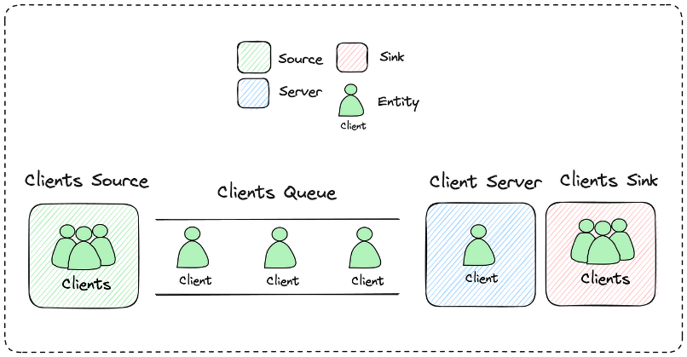
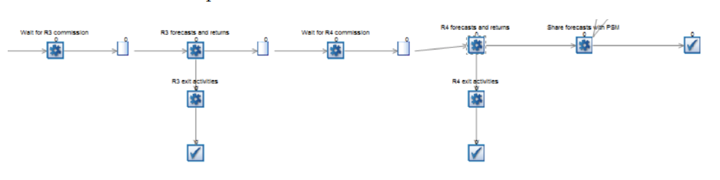
Discrete Event simulation
OFFICIAL : SENSITIVE
Models the behaviour of a system as a discrete sequence of events in time, each of which changes the state of the system in some way
Characterised by a series of activities, queues and resources, where the flow of items through the simulation can then be studied
Parameters for the length of time taken by activities and the number of resources available often given by random variables
Components of a DES: state; clock; events list; random number generators; ending condition
Simple application: a queuing system, such as customers arriving at a bank teller, where each customer is served in a time according to a given distribution
Notes:
Visual software like Simul8 often used for DES, where activities and queues can be seen in order

Slide 12
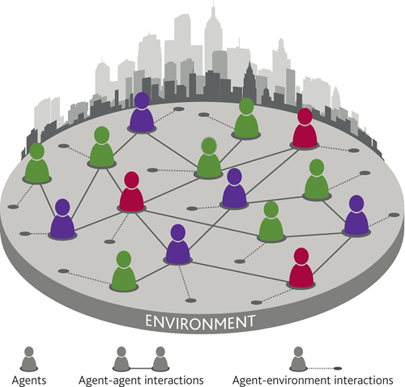

Agent-based modelling
OFFICIAL : SENSITIVE
Explains the behaviour of a system by simulating the behaviour of each individual ‘agent’ within it
Often utilised in ecology & economics
Focuses directly on individual objects / agents, their behaviour, and their interaction – rather than on the population split into pockets (as in system dynamics) or on the set of processes within a system (discrete event)
Agent-based models nowadays often utilise real, personalised data on the properties and behaviours of individuals
Simple application: modelling how the behaviour of each individual fish creates the seemingly organised and unpredictable movements of the shoal, or how the behaviour of each individual in a market creates trends
https://www.bankofengland.co.uk/-/media/boe/files/quarterly-bulletin/2016/agent-based-models-understanding-the-economy-from-the-bottom-up.pdf
https://www.anylogic.com/use-of-simulation/agent-based-modeling/
Notes:
Shows how even very simple behaviours can combine from the ‘bottom up’ to recreate more complex behaviours of systems seen in the real world

Slide 13
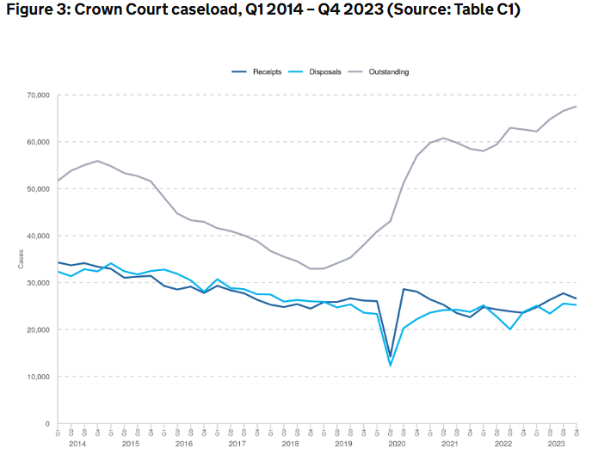
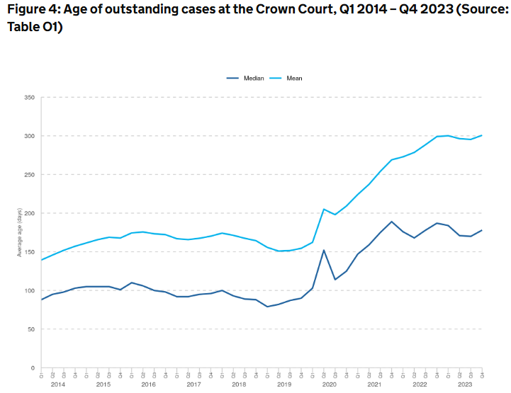
Case study: Crown Court Backlog
Source: Criminal court statistics quarterly: October to December 2023

Slide 14
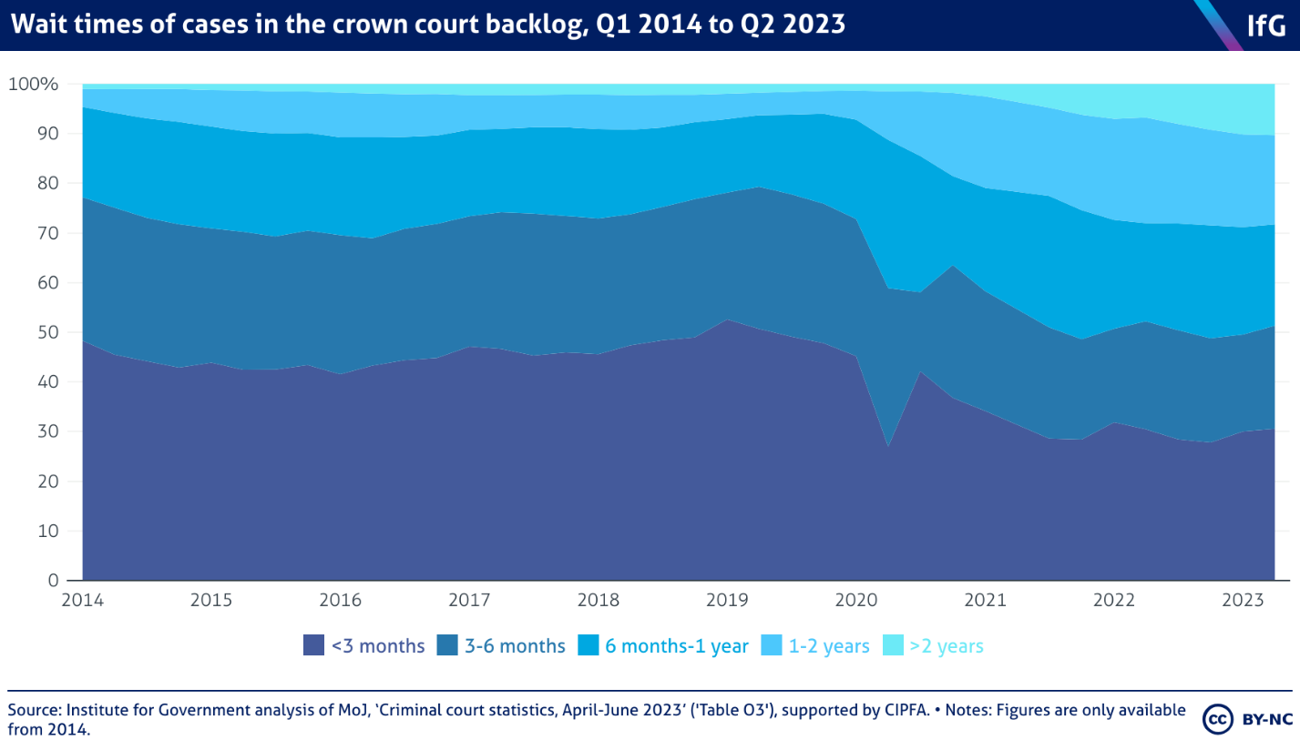
Why simulation?
Simulation allows us to forecast what might happen:
Under the status quo – with the current backlog and trends of the court system
If changes are made to the system, in scenario analysis
We can then answer distributional questions
“What % of cases will have a wait time >6 months?”
“How would adding X extra Crown Court rooms impact the backlog?”
Representing the process visually allows a detailed understanding of its different stages and where backlogs develop from
Source: https://www.instituteforgovernment.org.uk/publication/performance-tracker-2023/criminal-courts

Slide 15
Case study steps
1. Simulation Design
What type of simulation do we need for
our system?
2. Data Collection & Parametrization
Which parameters should our model have?
3. Output Analysis & Validation
Does the model accurately reflect the system?
4. Experimentation
How does the model perform under different scenarios?
5. Sensitivity Analysis
What effect does the changing of parameters
have on our outputs?

Slide 16
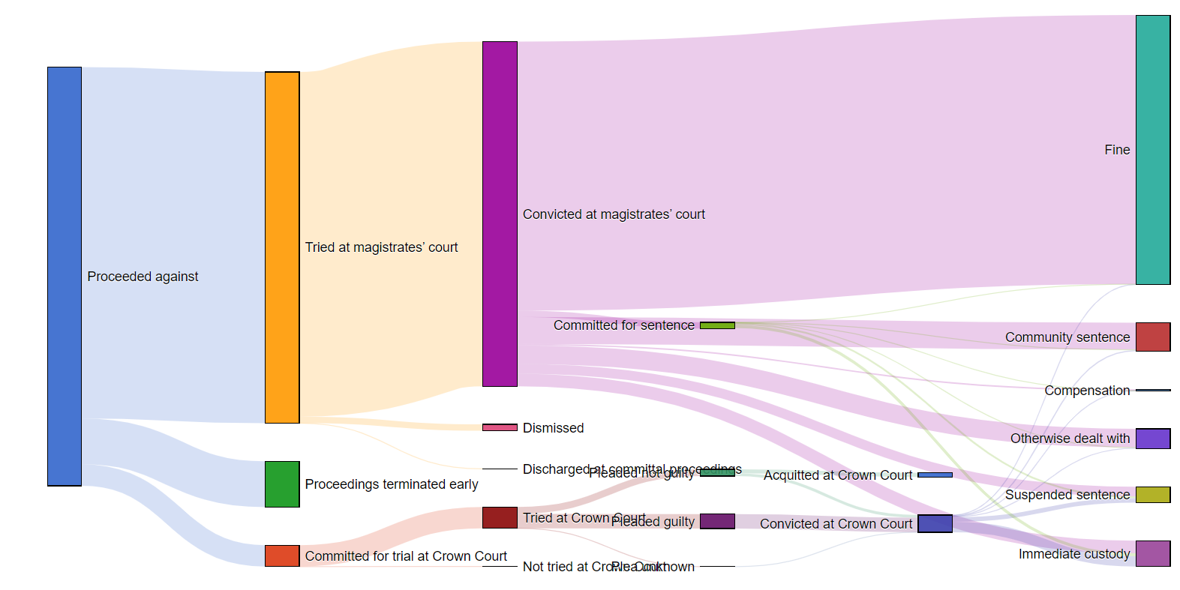
Understand underlying system
Simulation Design
Data collection and parameterisation
Output analysis and validation
Experimentation
Sensitivity analysis
Source: https://moj-analytical-services.github.io/criminal_justice_statistics_sankey/

Slide 17
Decide on appropriate approach
Simulation design
Data collection and parameterisation
Output analysis and validation
Experimentation
Sensitivity analysis
System model
We are interested in understanding:
Behaviour under a range of scenarios, with uncertainty
=> Probabilistic simulation
Trajectory of the system over time
=> Dynamic simulation
Movement of individuals between different stages of the system can be viewed as discrete events
=> Discrete event simulation
Parameters known or variable?
Deterministic
Probabilistic
Time frame?
Static
Dynamic
Static
(Monte Carlo)
Dynamic
When can the state of the system change?
Discrete
Continuous
Discrete
(Discrete event)
Stochastic

Slide 18
Design simulation
Simulation design
Data collection and parameterisation
Output analysis and validation
Experimentation
Sensitivity analysis
Resources:
Inputs:
Probability of case going to CC over MC
Probability of guilty / not guilty plea
Probability of guilty / not guilty plea
Average time for trial
Average time for sentencing hearing
Prison sentences distribution
Court & prison capacities
Crown Court (CC)
Magistrate’s Court (MC)
Prison
Random time taken generated
Found not guilty
Released
Not guilty plea
CC trial
(CC +1)
Plea entered in CC
Found guilty
CC sentencing hearing
(CC +1)
Prison sentence assigned
Prison population +1
Assigned to CC
Guilty plea
Arrival of individual
Random sentence generated
Random time taken generated
Found guilty
MC sentencing hearing
(MC +1)
Prison sentence assigned
Prison population +1
Assigned to MC
Plea entered in CC
Guilty plea
MC trial
(CC +1)
Random sentence generated
Not guilty plea
Found not guilty
Released
Random time taken generated

Slide 19
Data collection
Simulation design
Data collection and parameterisation
Output analysis and validation
Experimentation
Sensitivity analysis
Data source | Used for
Criminal court statistics quarterly – Ministry of Justice | Median time for Crown Court trials, sentencing, stratified by plea Probability of pleading guilty, being found guilty
Crown Court sitting days | Crown Court capacity (number of sitting days per year)
Notes:
Might want to say something about reliability and consistency etc

Slide 20
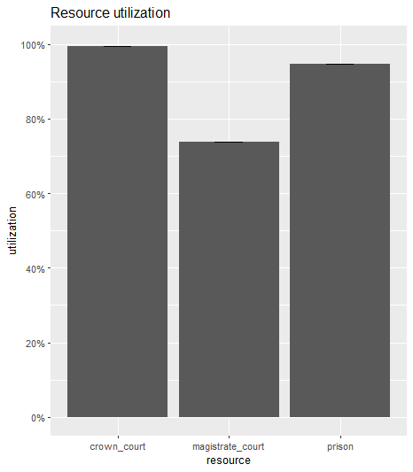
Analyse outputs
Simulation design
Data collection and parameterisation
Output analysis and validation
Experimentation
Sensitivity analysis
simmer environment: CrownCourtsSim | now: 1 | next: 1.00000012415256
{ Monitor: in memory }
{ Resource: crown_court | monitored: TRUE | server status: 292(292) | queue status: 126978(Inf) }
{ Resource: magistrate_court | monitored: TRUE | server status: 3957(5423) | queue status: 0(Inf) }
{ Resource: prison | monitored: TRUE | server status: 87900(87900) | queue status: 741574(Inf) }
{ Source: cases | monitored: 1 | n_generated: 1299656 }
We have a couple of conclusions:
With our initial conditions/assumptions, the relative number of crown courts and longer case times mean the system is far more dependent on the CC performance
This simulation shows there is capacity across the full system, if we don’t account for the backlog in cases

Slide 21
Experimentation
Simulation design
Data collection and parameterisation
Output analysis and validation
Experimentation
Sensitivity analysis
Can we alter parameters so that the backlog decreases?
What change would this represent within the system?
Modelling a sentencing only in Crown Courts
{ Resource: crown_court | monitored: TRUE | server status: 292(292) | queue status: 126978(Inf) }
{ Resource: magistrate_court | monitored: TRUE | server status: 3957(5423) | queue status: 0(Inf) }
Keeping Magistrate Court cases in MCs for sentencing (with an expected reduced sentencing hearing time):
{ Resource: crown_court | monitored: TRUE | server status: 292(292) | queue status: 34355(Inf) }
{ Resource: magistrate_court | monitored: TRUE | server status: 4014(5423) | queue status: 0(Inf) }

Slide 22
Sensitivity analysis
Simulation design
Data collection and parameterisation
Output analysis and validation
Experimentation
Sensitivity analysis
Questions which sensitivity analysis can answer:
When parameters are changed, what happens to the outputs?
Which parameters have the most significant impact on outputs?
How does the distribution of parameters affect the distribution of outputs?
Recommendable sensitivities for our case study:
Rate of arrivals to the system
Resource capacity of Crown Court, Magistrate’s Court and Prisons.
Different distributions for time taken for trials and sentencing hearings
Our model flowchart

Slide 23
Lessons learned
Obstacles to Simulation:
Reliant on input data – completely reliant on quality of data input to the model, which can often be difficult due to availability, reliability or consistency issues. Using recent historical data, e.g. based on post-pandemic times, might make system behave differently to how one would expect.
Time consuming – simulation is quite an involved technique, requiring significant time contributions and therefore is not appropriate where analysis is needed quickly.
Difficult to sense check inputs – it is hard to tell how reasonable input data is until initial results are obtained, and if these results appear strange, the cause of this is not always obvious – sensitivity analysis can be useful here.
Complicated output analysis required – due to the randomness involved in certain types of simulation, analysis to produce academically / statistically significant conclusions (e.g. confidence intervals) is often complex. Therefore, simulation may be most useful for “indicative” results.
Recommendations:
Carefully consider which technique is most suitable – in hindsight, using Monte Carlo would have been more straightforward than discrete event simulation, although it would have allowed fewer manipulations of the system.
Weigh up options for software – we used Simmer in R, but PySim and Simul8 are other options for simulation. It’s important to consider a) your own skills and b) the suitability of the programme.
Allow more time for sense checking & sensitivity analysis than you might expect!
Thoughts on Simmer package:
Reasonably straightforward to use, but lack of documentation online makes understanding more complex parts of the system difficult

Slide 24

Thank you!

